Slide 1
DELIVERABLE 1: PROJECT PROPOSAL

Slide 2
INTRODUCTION
In our presentation we will be presenting 2 ideas, with the first of the ideas being a way to monitor the movement patterns of people of a variety of ages, from young athletes to people of old age, and improve quality of life via remote monitoring, and the second of the ideas being a way to improve the safety standards in residential and commercial spaces via remote monitoring. Both of these ideas are low-cost and have the potential to be implemented into other monitoring systems.

Slide 3
IDEAS

Slide 4
IDEA 1 DESCRIPTION
(Smart movement monitoring system)
This idea works as follows:
Consists of an Arduino board, accelerometer sensor, 555 timer and Wi-Fi module.
The accelerometer monitors the motion of the user
Any abrupt movements will trigger the alert, which will notify family members if the user has fallen (for people of old age) or the athlete’s coach if an injury has occurred (for athletes)

Slide 5
JUSTIFICATIONS FOR IDEA 1
Can be used in research conditions to understand the underlying cause of movement abnormalities by studying walking patterns
Can be used to provide personalised treatment for patients by increasing accuracy of the data of their walking patterns
Can help reduce healthcare costs by identifying problems early on, reducing the need for expensive treatments and procedures

Slide 6

BENEFITS FOR IDEA 1
Improved patient outcomes
Remote monitoring
Reduced risk of injury

Slide 7
PROSPECTIVE MARKET: IDEA 1
Physical therapy clinics (monitoring patient progress via movement analysis)
Rehab centers (monitor and help patients recover from injuries or surgeries)
Sports and fitness centres (monitoring athletes’ and fitness enthusiasts’ movement patterns and optimise to prevent injuries)

Slide 8
IDEA 2 DESCRIPTION
(Gas leakage detector)
This idea will operate as follows:
Consists of an Arduino board, gas sensor, 555 timer and Wi-Fi module
Gas sensor will detect hazardous gases in the air and shows status on LCD screen
Buzzer will sound if gas leak is detected and an SMS will notify the user to take precautions

Slide 9
JUSTIFICATION OF IDEA 2
Helps prevent costly repairs and replacements by detecting gas early, which can save time and money
Helps comply with safety and environmental regulations
Improves building efficiency by reducing risk to equipment and machinery, which can also improve productivity and reduce downtime

Slide 10
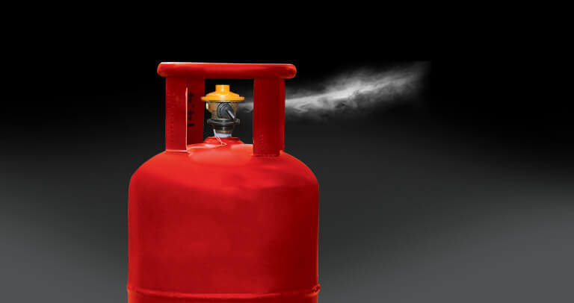
BENEFITS OF IDEA 2
Safety (at home or in workplace)
Environmental protection
Remote monitoring

Slide 11
PROSPECTIVE MARKET: IDEA 2
Industrial plants (can detect harmful gases like carbon monoxide and sulfur dioxide)
Commercial Buildings (can be useful for preventing excess carbon monoxide or carbon dioxide buildup)
Residential Buildings (can be useful for preventing the same kinds of gas buildup as in commercial buildings)

Slide 12

PRELIMINARY DESIGN

Slide 13
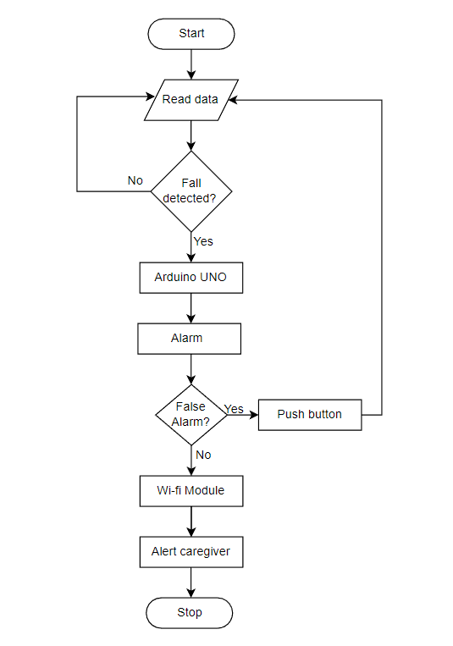
FLOWCHART: IDEA 1

Slide 14
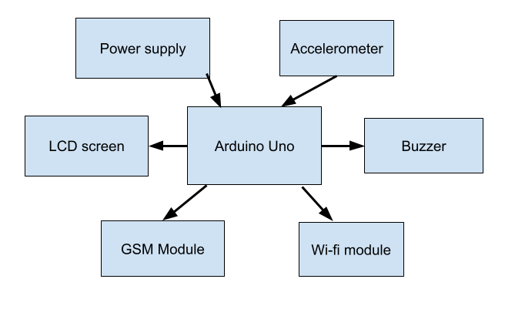
BLOCK DIAGRAM: IDEA 1

Slide 15
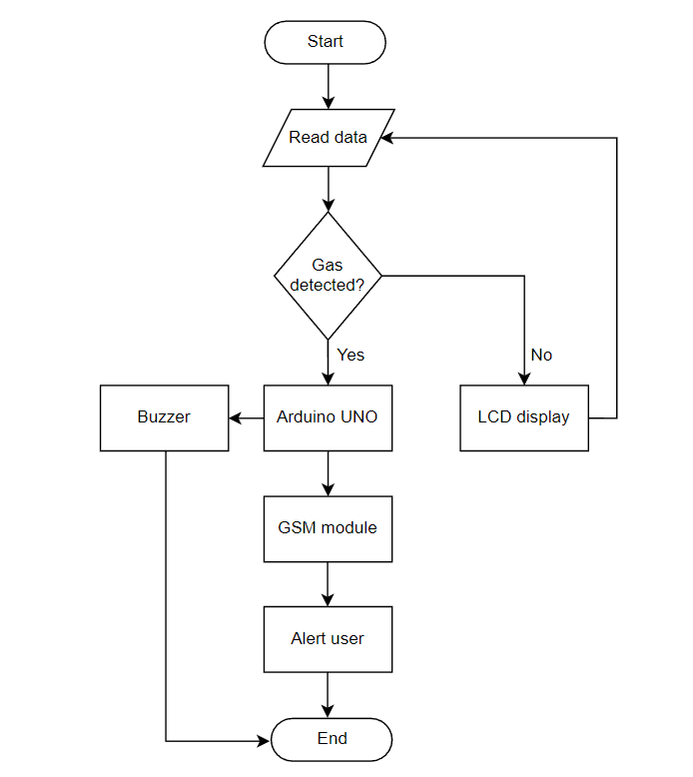
FLOW CHART: IDEA 2

Slide 16
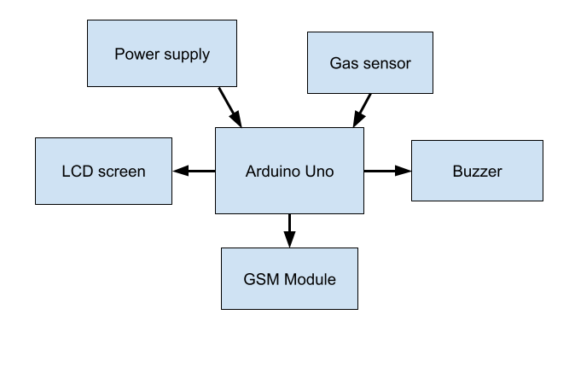
BLOCK DIAGRAM: IDEA 2

Slide 17

COST

Slide 18
LABOR COST ESTIMATION
 | Expected Time(Hours) | Labor Cost
Deliverable 1 | 5 | 1500
Deliverable 2 | 10 | 3000
Deliverable 3 | 10 | 3000
Deliverable 4 | 9 | 2700
Deliverable 5 | 15 | 4500
Deliverable 6 | 20 | 6000
Deliverable 7 | 10 | 3000
Deliverable 8 | 17 | 5100
Total Hours: 96
Total Cost : 28,800

Slide 19
PARTS COST ESTIMATION: IDEA 1
Components Required: Arduino UNO, Wires, Breadboard and Switch.
covered in 600 dhs budget
Accelerometer: 60 dhs
GSM chip: 70 dhs
Wifi module : 20 dhs
Ultrasonic sensor : 15 dhs
TOTAL : 765 dhs

Slide 20
PARTS COST ESTIMATION: IDEA 2
Components Required: Arduino UNO, Wires, Breadboard and Switch.
covered in 600 dhs budget
Gas Sensor : 25 dhs
LED’s *4 : 20 dhs
Potentiometer *2 : 20dhs
LCD display : 32 dhs
Buzzer :25 dhs
GSM chip: 70 dhs
TOTAL: 792 dhs

Slide 21
THANKS FOR LISTENING QUESTIONS?

